Slide 1

La geotermia
nella policy europea
Genova, 23 Settembre 2023
Marco Baresi – Vice Presidente EGEC

Slide 2
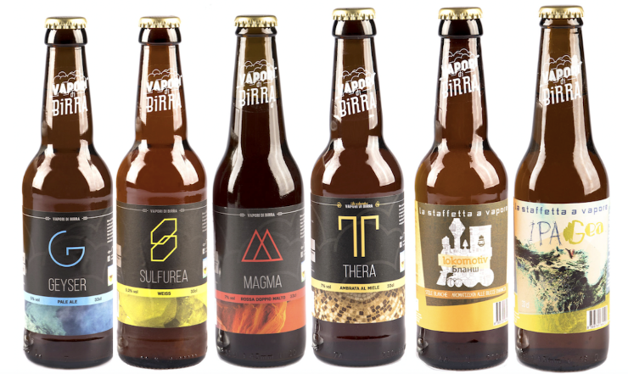
Geothermal iconic products

Slide 3

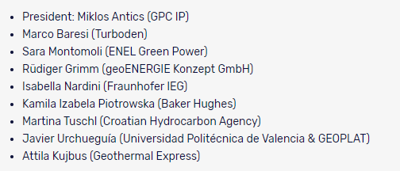
EGEC – European Geothermal Energy Council
Fondata nel 1998 Bruxelles
30 paesi rappresentati
180 membri
  developers
  fornitori tecnologia,
  utilities ed enti pubblici
  associazioni nazionali
  centri di ricerca
  geological surveys
https://www.egec.org/

Slide 4
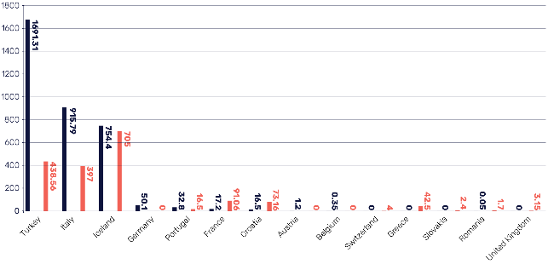
Overview (EU market report 2022)
Some key figures
142 Geothermal electricity plants: 3,5 GWe installed and more than 22 TWh produced
395 geothermal District Heating systems in operation, with 14 new in 2022: 5,6 GWth capacity
More than 2,19 million geothermal heat pumps in Europe at the end of 2022

Slide 5
Market analysis
1913 - 2023: Celebrating 110 years of geothermal power
The oldest geothermal power plant is still in operation is from 1986.
4 running plants are from the 80‘s, 17 from the 90‘s and 32 plants run from the 2000‘s.
21 power plants are more than 25 years old and 53 are more than 15 years old.
The geothermal electricity market is now entering a new development phase, with many plants to be put into operation throughout the next 5 to 7 years.
In total, today, 43 projects are developed and 140 are investigated.

Slide 6
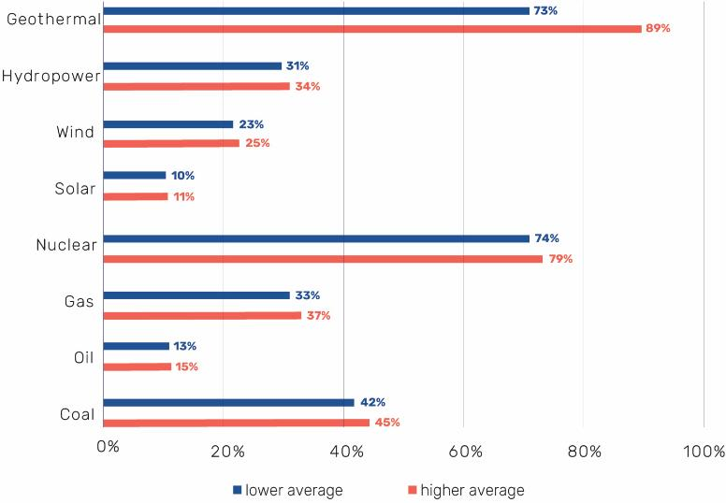
Need of Baseload
«Capacity factor is the annual generation of a power plant (or fleet of generators) divided by the product of the capacity and the number of hours over a given period. In other words, it measures a power plant's actual generation compared to the maximum amount it could generate in a given period without any interruption» [ScienceDirect]
Average European capacity factor per electricity sources, 2022

Slide 7
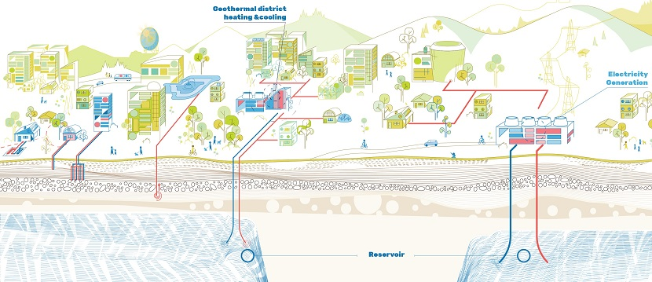
Geothermal for Europe, targets to cover…
25% of Heating and cooling demand
10% of Power generation
Underground thermal storage for 50% of the District Heating
Co-production of minerals: 20% of lithium demand
Graphic courtesy EGEC
Notes:
The four elements that geothermal can bring
Electricity
Heating and cooling
Storage
Geothermal mining (Li)
With pictures that show what is going on.
Maybe pictures of the product? So electricity grid, the warm floor, Li salt. How to explain storage then? Oil tanks? Not too bad, really, because it is a similar function?
Or do we have icons/schematic drawings of all of these in the same style. Or three of these, with one to be developed in the coming 3 weeks
Pictures of actual installations is also an option, but how do you see whether it is storage or heat production from the wellhead?

Slide 8
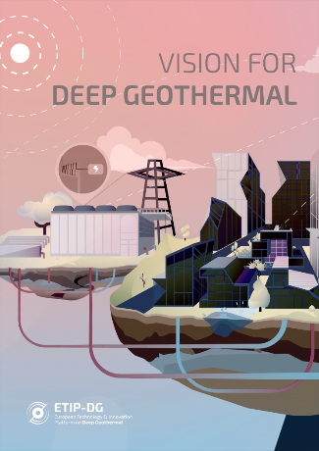

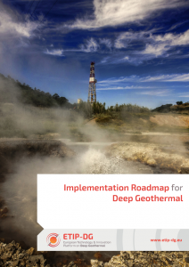
ETIP – EU Technology Innovation Platform Geothermal
https://www.etip-dg.eu/

Slide 9
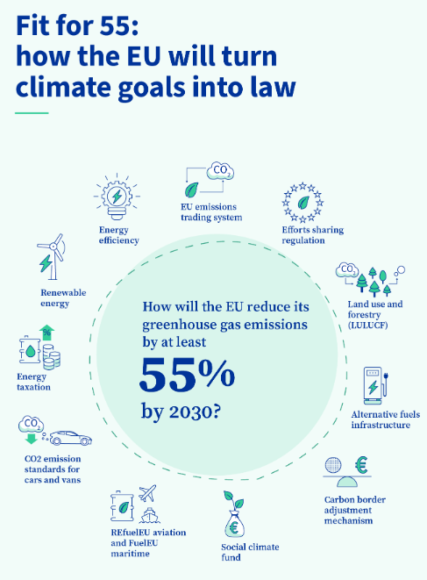
Fit for 55 package measures for geothermal
financial risk mitigation frameworks for renewable heating: creation of risk mitigation frameworks (RES Directive)
Local authority mandate on RES H&C planning (Energy Efficiency Directive /RES Directive)
Urban areas with a population of 45 000 inhabitants will be required to plan renewable heating and cooling networks.

Slide 10
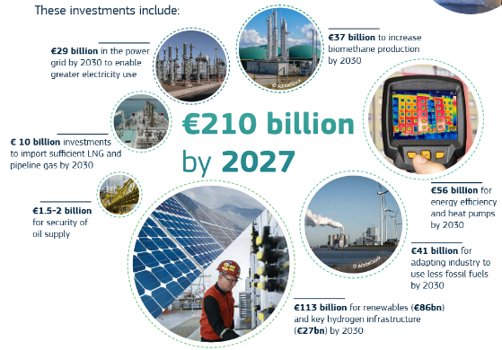
REPowerEU
Reacting to the energy crisis
A plan to rapidly reduce dependence on Russian fossil fuels and fast forward the green transition.
Key Measures for Geothermal:
target for the capacity of geothermal to triple by 2030
“renewable go-to areas“ (to be included in the RES Directive revision): simplify permitting procedures
Fast permitting for geothermal heat pump systems (three months maximum)
Large skills partnership: geothermal needs DRILLERS !

Slide 11
RED III and Net Zero Industrial Act (NZIA)
Key Measures for Geothermal (RED III):
Renewable energy sources (RES) share target is set at 42,5% by 2030, with plans to increase it to 45% in a non-binding manner
“Renewable go-to areas (RGTA)“ and Fast permitting procedure for deploying renewables (12 months max in RGTA, 24 outside)
Binding target for RES share in Heating & Cooling, with an annual increase: + 0.8% for 2021-2025 and + 1.1 % for 2026-2030
From 2045 on both Waste heat recovery and RES will be the only energy sources allowed for Efficient District Heating Cooling
Key Measures for Geothermal (NZIA):
Simplifying the regulatory framework for net-zero technologies
Scaling up manufacturing of net-zero technologies
Fostering competitive and resilient European net-zero industry
Geothermal Energy and Heat Pumps among the 8 Strategic net-zero technologies
Net-Zero Industry Valleys, aimed at fostering industrial collaboration and encouraging MS to make targeted investments in specific areas within the EU
Proposal for MS to allocate 25% of Emissions Trading System (ETS) revenues for expenditure aimed at achieving the objectives of the NZIA.

Slide 12






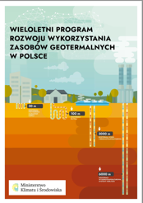

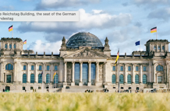

Government’s going ahead anyway
Double Geothermal HP by 2025 & Geothermal DH by 2030
Risk guarantee scheme.
Focus on Geothermal HPs and DHC system
Exploration and production licence law by 2024.
600,000 HPs by 2030. Expect half to be geothermal and DHC
Risk guarantee scheme.
100TWh from 100 new Geothermal HP and Geothermal DHC systems by 2030.
Hybrid Heat Pump Plan
Subsidies for heat pump purchase and support for DHC systems. 2billion given to geothermal deployment in May 2023

Slide 13
Next steps
Focus shifting to Member State implementation. Key areas are:
National Energy & Climate Plans (NECPs): Member States will update by June 2024 their national policies and measures to meet the new climate and energy targets
National geothermal strategies: France, Germany, Poland and Ireland issued national strategies for geothermal in 2022/2023 and are legislating now to mainstream it. Denmark, Finland, Netherlands and Hungary have support measures for geothermal district heating and heat pumps
Renewable ’go-to areas’: These identify where geothermal and other renewable plants can be built and a streamlined permitting process. Essential to use this as an opportunity for geological surveys to map geothermal potentials and capacity building for permitting agencies using the Life-cycle environmental impact assessment tool
Geothermal lithium: support from the Critical Raw Materials Act and
the Green Deal Industrial Plan to support investment in new capacity
Notes:
FRANCE
. Double the rate of GSHP install by 2025= installing more than 200.000 units in 3 years, producing about 7 TWh
• increase the installed deep GT DH by 40% = from 78 plants in operation to more than 110 plants by 2028 = more than 30 new projects
• Key measures: Supported by training programs (drillers notably), simplify regulations and promotional campaign
• incentives: minimum 5.000 € and up to 16.000 € for individual geothermal HP
• geothermal heat for DH and industry: resource assessment program, financing programmes

Slide 14
The missing pieces of the jigsaw
Harmonised financial risk mitigation: Germany and Poland preparing financial risk mitigation schemes as outlined in government agreements or national roadmaps. Netherlands updating SDG++. However, need to continue to advocate for an EU or regional financial scheme.
Heat Purchase Agreement (HPA) market: Crucial for an industry-led approach to developing the market for geothermal HPAs based on power generation, cogeneration or trigeneration models.
Geothermal Action Plan: In 2023 the geothermal industry is calling for a European geothermal strategy. EGEC is proposing to set up an industrial partnership, similar to those for hydrogen, biomethane and PV, to directly regulate the market for geothermal across the EU.

Slide 15
The voice of geothermal in Europe
#geothermaldecade

